Slide 1

MBEYA UNIVERSITY OF SCIENCE & TECHNOLOGY COLLEGE OF ICT DEPT. OF COMPUTER SCIENCE & ENGINEERING PROPOSAL PRESENTATION
PROJECT TITLE: DEVELOPMENT OF TOBACCO LEAF DISEASE DETECTION AND QUALITY GRADING SYSTEM
STUDENT NAME: NICHOLAUS NUNGU WAROBI
STUDENT REG.NO: 22100533590017
SUPERVISOR’S NAME/S: SIR. PASCAL YAMAKILI

Slide 2
Main & Specific Objectives
General Objective To develop a system for the detection of leaf diseases and quality grading of tobacco leaves.
Specific Objectives
i. To collect image data of tobacco leaves showing healthy, diseased, and different quality grades.
ii. To build a system that can identify tobacco leaf diseases from images.
iii. To develop a system that can classify tobacco leaves into grades (Grade A, B, C).
iv. To train and test the system to ensure accurate and reliable results.
v. To design a user-friendly system that allows users to upload images and receive disease detection and grading results.

Slide 3
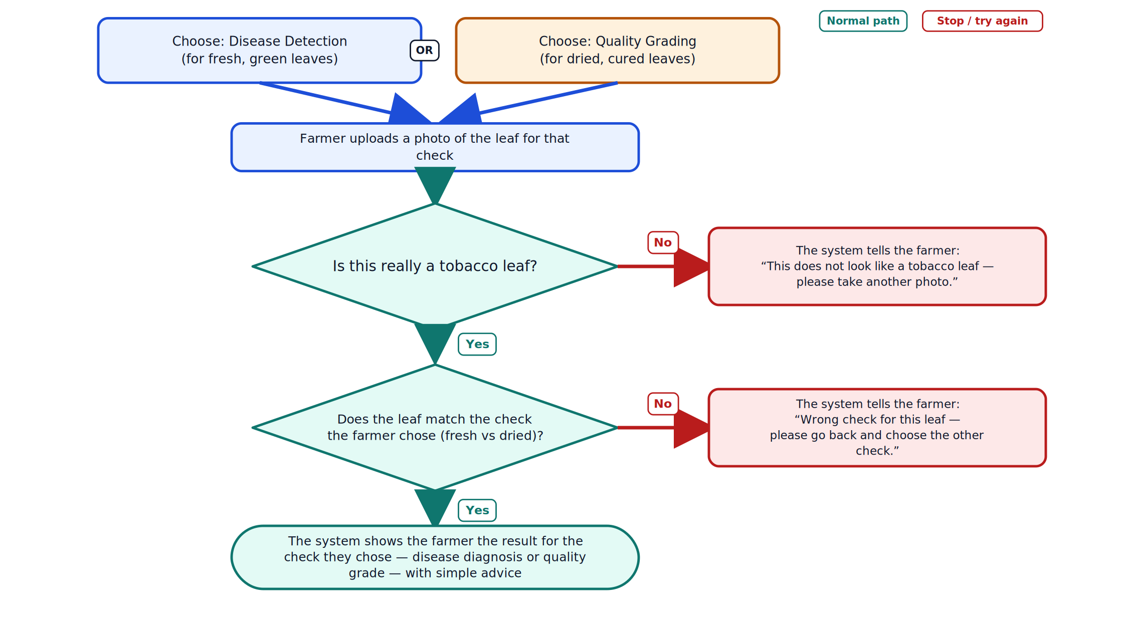
SYSTEM DESIGN

Slide 4
THANKS

